Slide 1
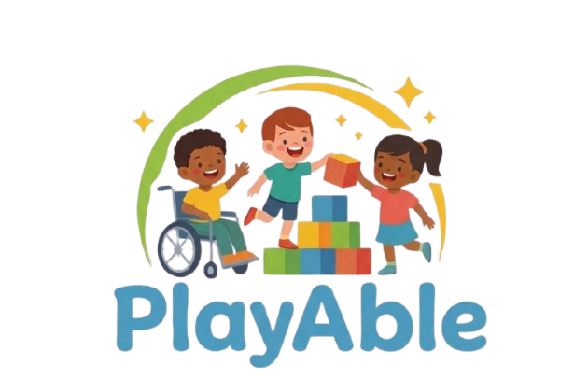
Notes:
Welcome slide. Introduce the team and the mission of PlayAble. Emphasize the inclusive vision.

Slide 2
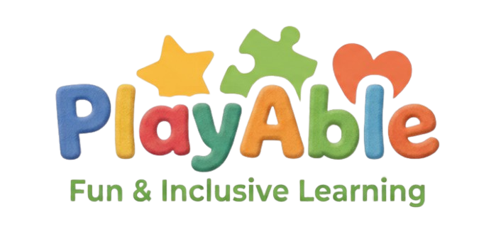
STARTUP PITCH DECK
Empowering Every Child to Learn & Play
Notes:
Welcome slide. Introduce the team and the mission of PlayAble. Emphasize the inclusive vision.

Slide 3
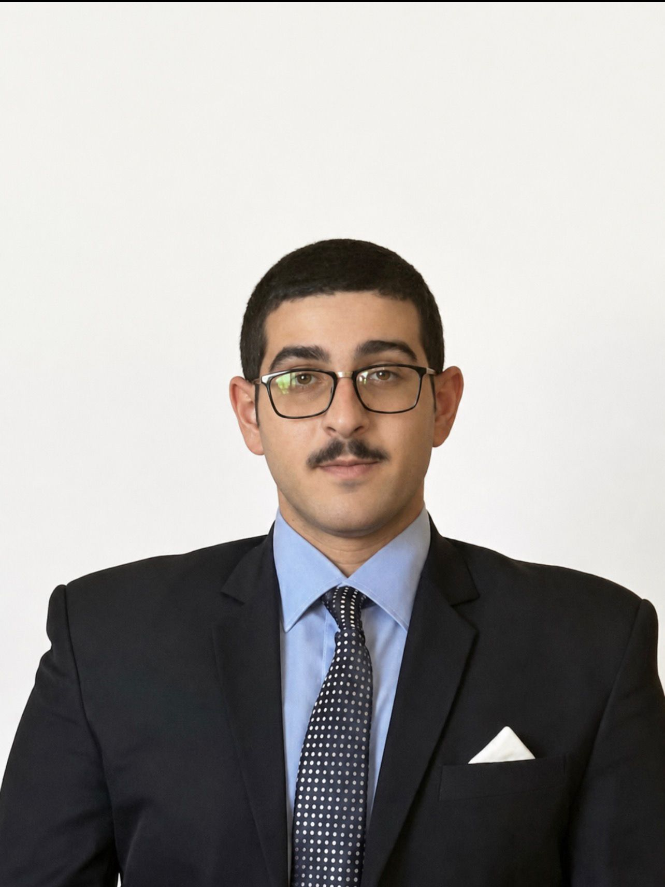
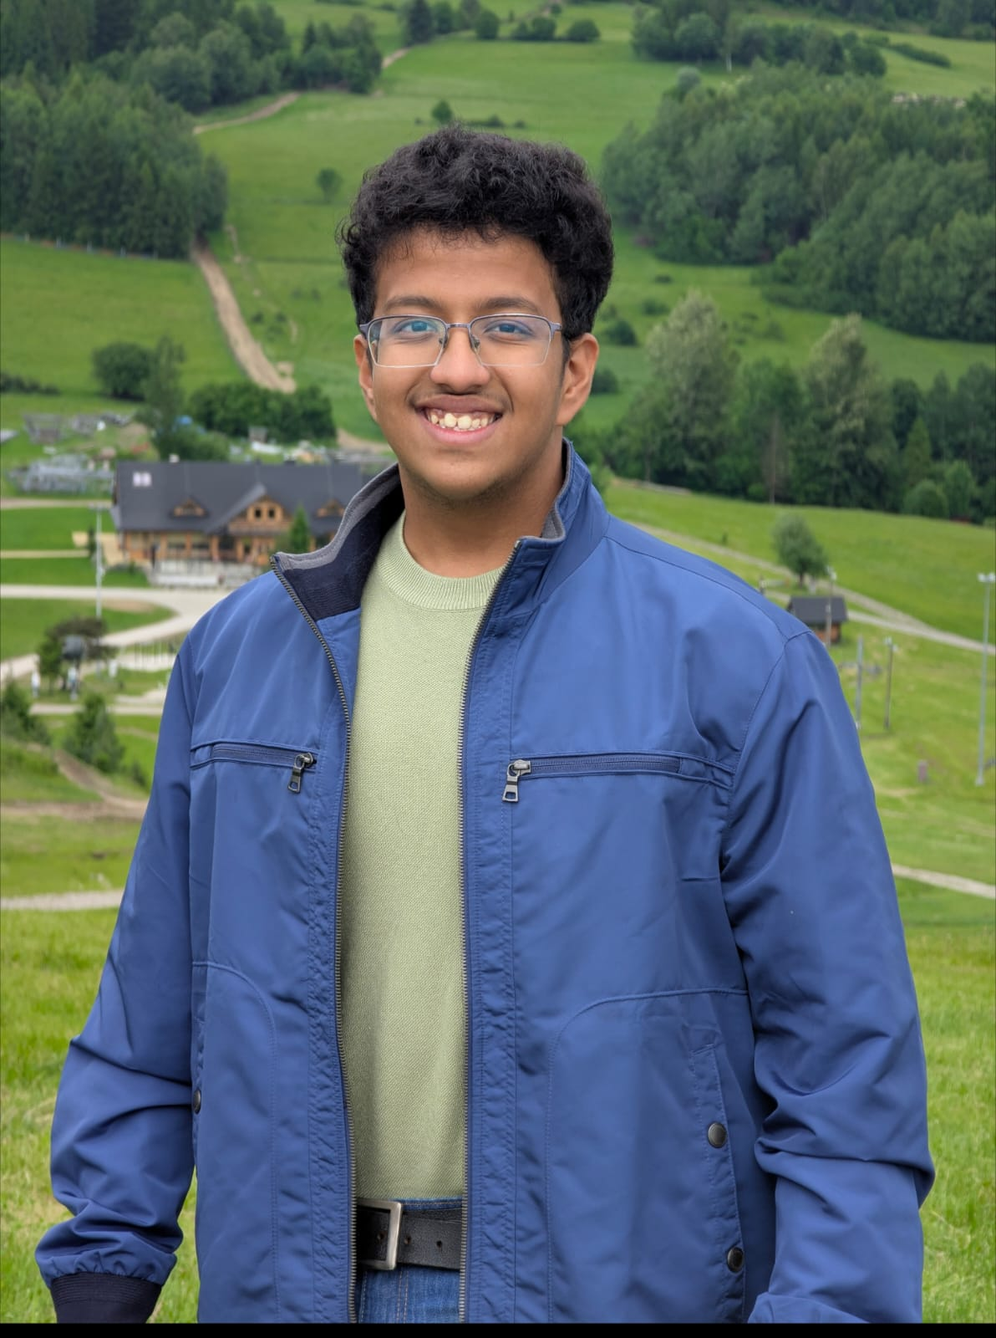
Our Team
QIES SLOULIN
Soham Phansalkar
Notes:
Introduce the team members by name. Explain how each person's background is critical to PlayAble's mission.

Slide 4
The Problem
Scale
Gap
Impact
1 in 6 children in the US has a developmental disability
Existing educational tools rarely adapt to children with Cerebral Palsy or similar conditions
Traditional classrooms lack personalized, tech-driven interaction for special needs kids
Notes:
Discuss the educational gap for children with special needs, particularly those with Cerebral Palsy. Mention Anya as the inspiration.

Slide 5

Meet Anya
Cerebral Palsy Facts
Our Inspiration
~17M
people worldwide have CP
Anya has Cerebral Palsy
1 in 345
children in the US is diagnosed
She loves learning but struggles with: • Standard input devices (mouse/keyboard) • One-size-fits-all educational software • Lack of adaptive, engaging tools PlayAble was built with Anya in mind — and for every child like her.
Lifelong
condition — early learning is critical
Limited
adaptive Educational Tech tools exist today
Notes:
Tell Anya's story. She is the human face of our mission. This slide builds emotional connection with the audience.

Slide 6
Our Solution
An adaptive educational platform combining physical hardware with smart software
Smart Web App
ESP32 Hardware
Personalized learning modules, adaptive UI designed for children with motor challenges
Custom physical controller connected via IoT — enabling intuitive interaction for limited-mobility users
Adaptive AI
Child-Centered UX
Content adjusts in real-time to child's pace, ability, and engagement patterns
Colorful, joyful interface built with accessibility standards (WCAG) and inclusive design
Notes:
Explain the four pillars of the PlayAble platform. Highlight the ESP32 hardware integration as our unique differentiator.

Slide 7
Technology Stack
SOFTWARE
HARDWARE
✓ Web Application (React / HTML5)
✓ ESP32 Microcontroller (Wi-Fi + BT)
✓ Responsive & Accessible UI (WCAG)
✓ Custom Adaptive Input Device
ESP
32
✓ Real-time Adaptive Content Engine
✓ Real-time Sensor Data Processing
✓ User Progress Analytics Dashboard
✓ OTA (Over-the-Air) Firmware Updates
✓ Cloud-hosted Backend & APIs
✓ Low-latency Hardware↔Software Bridge
Notes:
Walk through the tech stack. Emphasize the seamless connection between the ESP32 hardware and the web app.

Slide 8
How It Works
1
2
3
4
Child Uses Device
Signal Sent
App Responds
Progress Tracked
Anya interacts with the ESP32 controller custom buttons, switches, or sensors matched to her ability
ESP32 transmits interaction data wirelessly to the web application in real time
The web app processes inputs, advances the learning activity, and adapts difficulty accordingly
Parents and educators receive a dashboard update showing engagement, progress, and achievements
Notes:
Demonstrate the end-to-end flow. Use a live demo if possible during the presentation.

Slide 9
Where We Are Now
Project Status: Active Development 🟢
Company Concept & Branding
100%
Website Development
65%
ESP32 Hardware Prototyping
50%
Software–Hardware Integration
30%
Pilot Testing with Anya
10%
Beta Launch
0%
Notes:
Honest progress update. Show momentum. Emphasize the active development phase and what has been completed vs in progress.

Slide 10
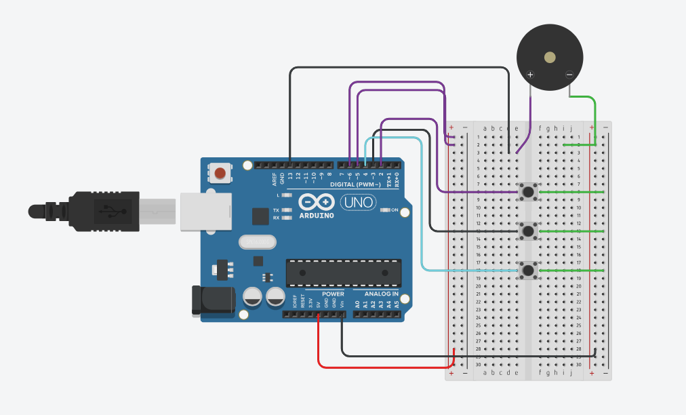
Circuit Diagram
Notes:
Honest progress update. Show momentum. Emphasize the active development phase and what has been completed vs in progress.

Slide 11
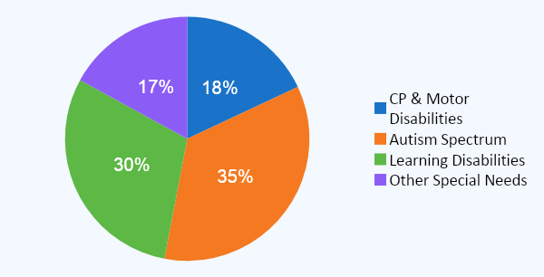
Market Opportunity
$15B
7.6M
34%
Global Special Ed Tech Market (2025)
US Students with Disabilities
CAGR in Adaptive EdTech
PlayAble targets the underserved segment of
CP & Motor Disability adaptive tools — our
clearest blue ocean in the EdTech space.
Notes:
Highlight the large and growing market. Focus on the CP segment being underserved by existing solutions.

Slide 12
Join Us in Making Learning
Accessible for Every Child
Invest
Partner
Advise
Fund our MVP launch and pilot program
Schools, clinics, and therapy centers
Special ed experts & accessibility pros
Notes:
Close with passion. Invite the audience to be part of PlayAble's journey — whether as investors, school partners, or advisors. End with Anya's story.

